Slide 1
ECE408/CS483 Fall 2016 Applied Parallel Programming Lecture 29: Summary and Future Directions

Slide 2
Objective
To solidify your understanding and point you to the future
Future directions of programming models
Next courses
Important takeaways from the course, exam plan
Course evaluation

Slide 3
Higher-Level Programming Interfaces

Slide 4
OpenACC
The OpenACC Application Programming Interface provides a set of
compiler directives (pragmas)
library routines and
environment variables
that can be used to write data parallel FORTRAN, C and C++ programs that run on accelerator devices including GPUs and CPUs

Slide 5
OpenACC Pragmas
In C and C++, the #pragma directive is the method to provide, to the compiler, information that is not specified in the standard language.

Slide 6
Simple Matrix-Matrix Multiplication in OpenACC
1 void computeAcc(float *P, const float *M, const float *N, int Mh, int Mw, int Nw)
2 {
3
4 #pragma acc parallel loop copyin(M[0:Mh*Mw]) copyin(N[0:Nw*Mw]) copyout(P[0:Mh*Nw])
5 for (int i=0; i<Mh; i++) {
6 #pragma acc loop
7 for (int j=0; j<Nw; j++) {
8 float sum = 0;
9 for (int k=0; k<Mw; k++) {
10 float a = M[i*Mw+k];
11 float b = N[k*Nw+j];
12 sum += a*b;
13 }
14 P[i*Nw+j] = sum;
15 }
16 }
17 }

Slide 7
Some Observations
The code is almost identical to the sequential version, except for the two lines with #pragma at line 4 and line 6.
OpenACC uses the compiler directive mechanism to extend the base language.
#pragma at line 4 tells the compiler to generate code for the ‘i’ loop at line 5 through 16 so that the loop iterations are executed in parallel on the accelerator.
The copyin clause and the copyout clause specify how the matrix data should be transferred between the host and the accelerator. The #pragma at line 6 instructs the compiler to map the inner ‘j’ loop to the second level of parallelism on the accelerator.

Slide 8
Motivation
OpenACC programmers can often start with writing a sequential version and then annotate their sequential program with OpenACC directives.
leave most of the details in generating a kernel and data transfers to the OpenACC compiler.
OpenACC code can be compiled by non-OpenACC compilers by ignoring the pragmas.

Slide 9
Frequently Encountered Issues
Some OpenACC pragmas are hints to the OpenACC compiler, which may or may not be able to act accordingly
The performance of an OpenACC depends heavily on the quality of the compiler.
Much less so in CUDA or OpenCL
Some OpenACC programs may behave differently or even incorrectly if pragmas are ignored

Slide 10
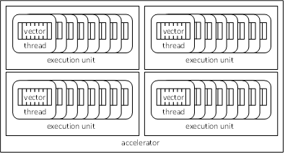
OpenACC Device Model
Currently OpenACC does not allow synchronization across threads.

Slide 11
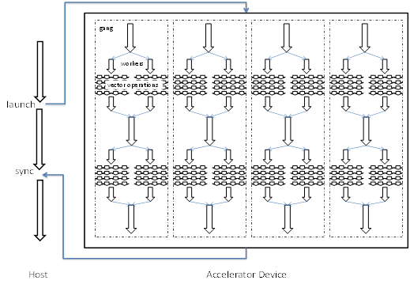
OpenACC Execution Model

Slide 12
Parallel vs. Loop Constructs
#pragma acc parallel loop copyin(M[0:Mh*Mw]) copyin(N[0:Nw*Mw]) copyout(P[0:Mh*Nw])
for (int i=0; i<Mh; i++) {
…
}
is equivalent to:
#pragma acc parallel copyin(M[0:Mh*Mw]) copyin(N[0:Nw*Mw]) copyout(P[0:Mh*Nw])
{
#pragma acc loop
for (int i=0; i<Mh; i++) {
…
}
}
(a parallel region that consists of just a loop)

Slide 13
Parallel Construct
A parallel construct is executed on an accelerator
One can specify the number of gangs and number of works in each gang
#pragma acc parallel copyout(a) num_gangs(1024) num_workers(32)
{
a = 23;
}
1024*32 workers will be created. a=23 will be executed redundantly by all 1024 gang leads

Slide 14
What does each “Gang Loop” do?
#pragma acc parallel num_gangs(1024)
{
for (int i=0; i<2048; i++) {
…
}
}
#pragma acc parallel num_gangs(1024)
{
#pragma acc loop gang
for (int i=0; i<2048; i++) {
…
}
}

Slide 15
Worker Loop
#pragma acc parallel num_gangs(1024) num_workers(32)
{
#pragma acc loop gang
for (int i=0; i<2048; i++) {
#pragma acc loop worker
for (int j=0; j<512; j++) {
foo(i,j);
}
}
}
1024*32=32K workers will be created, each executing 1M/32K = 32 instance of foo()

Slide 16
#pragma acc parallel num_gangs(32)
{
Statement 1; Statement 2;
#pragma acc loop gang
for (int i=0; i<n; i++) {
Statement 3; Statement 4;
}
Statement 5; Statement 6;
#pragma acc loop gang
for (int i=0; i<m; i++) {
Statement 7; Statement 8;
}
Statement 9;
if (condition)
Statement 10;
}
Statements 1 and 2 are redundantly executed by 32 gangs
The n for-loop iterations are distributed to 32 gangs

Slide 17
Key to Programming to OpenACC
Understanding the Gangs (thread blocks) and Workers (threads)
Understanding the data copyin copyout
Understanding the amount of work done by each worker
The best way to learn to program in OpenACC well is to learn CUDA first

Slide 18
Next Steps
Computational Thinking and Algorithm Techniques
Notes:
Computational Thinking and Algorithm Techniques

Slide 19
Fundamentals of Parallel Computing
Parallel computing requires that
The problem can be decomposed into sub-problems that can be safely solved at the same time
The programmer structures the code and data to solve these sub-problems concurrently
The goals of parallel computing are
To solve problems in less time, and/or
To solve bigger problems, and/or
To achieve better solutions
The problems must be large enough to justify parallel computing and to exhibit exploitable concurrency.

Slide 20
Shared Memory vs. Message Passing
We have focused on shared memory programming
This is what CUDA (and OpenMP/OpenACC, OpenCL) is based on
Future massively parallel microprocessors are expected to support shared memory at the chip level
This is different than global address space (single pointer space)
The programming considerations of message passing model is quite different!
Look at MPI (Message Passing Interface) and its relatives such as Charm++

Slide 21
Program Models
SPMD (Single Program, Multiple Data)
All PE’s (Processor Elements) execute the same program in parallel, but has its own data
Each PE uses a unique ID to access its portion of data
Different PE can follow different paths through the same code
This is essentially the CUDA Grid model (also MPI)
SIMD is a special case - WARP
Master/Worker (CUDA Streams)
Loop Parallelism (OpenMP/OpenACC)
Fork/Join (Posix p-threads)

Slide 22
A Simple Example of Parallel Programming Pitfalls
Assume
The computation being parallelized has 1,000,000 iterations.
Sequential code:
Num_steps = 1000000;
for (i=0; i< num_steps, i++) {
…
}

Slide 23
SPMD Code Version 1
Assign a chunk of iterations to each thread
The last thread also finishes up the remainder iteartions
num_steps = 1000000;
i_start = my_id * (num_steps/num_threads);
i_end = i_start + (num_steps/num_threads);
if (my_id == (num_threads-1)) i_end = num_steps;
for (i = i_start; i < i_end; i++) {
….
}
Reconciliation of results across threads if necessary.

Slide 24
Problems with Version 1
The last thread executes more iterations than others
The number of extra iterations is up to the total number of threads – 1
This is not a big problem when the number of threads is small
When there are thousands of threads, this can create serious load imbalance problems.

Slide 25
SPMD Code Version 2
Assign one more iteration to some of the threads
int rem = num_steps % num_threads;
i_start = my_id * (num_steps/num_threads);
i_end = i_start + (num_steps/num_threads);
if (rem != 0) {
if (my_id < rem) {
i_start += my_id;
i_end += (my_id +1);
}
else {
i_start += rem;
i_end += rem;
}
.
Less load imbalance
More branch divergence.

Slide 26
SPMD Code Version 3
Use cyclic distribution of iteration
num_steps = 1000000;
for (i = my_id; i < num_steps; i+= num_threads) {
….
}
Less load imbalance
Loop branch divergence in the last Warp

Slide 27
Comparing the Three Versions
Version 1
ID=0
ID=1
ID=2
ID=3
Version 2
ID=0
ID=1
ID=2
ID=3
Version 3
ID=0
ID=1
ID=2
ID=3
Padded version1 1 may be best
for some data access patterns.

Slide 28
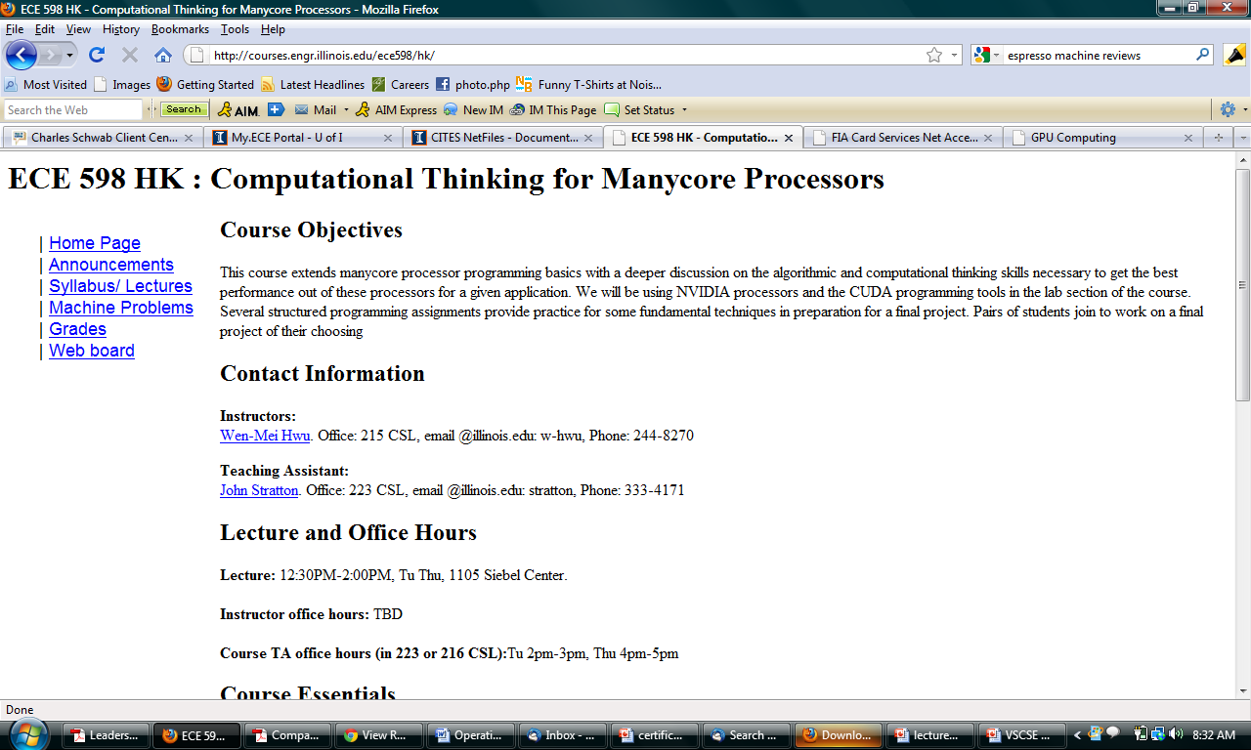
ECE 598HK courses.ece.uiuc.edu/ece598/hk

Slide 29
Eight Optimization Patterns for Algorithms (so far)
http://courses.engr.illinois.edu/ece598/hk/
GPU Computing Gems, Vol. 1 and 2

Slide 30
Main Takeaways 2nd Exam

Slide 31
Key Points
Parallelization
Sufficient work for each thread, thread block
Memory access patterns and data reuse
Choice of loop levels and loop transformation
Privatization
Reduced intensity of global atomic conflicts
Much higher throughput of atomic operations
Limited size of shared memory

Slide 32
Key Points (cont.)
Atomic Operations
Main means of collaborative data updates
Throughput is inversely proportional to latency
Global memory, L2 cache, shared memory
Asynchronous Operations
CUDA streams
Pinned memory allocation
Overlap of data transfers and kernel execution
Ordering of asynchronous calls important
Double and triple buffers

Slide 33
Key Points (cont.)
Sparse Matrix
Compression schemes CSR, ELL, OOO, JDS
Pointer structures in each scheme
Indexing into the matrix and the vectors
Control divergence and memory coalescing
Convolution Neural Networks
Structure – convolution, subsampling, fully connected
Matrix formulation vs. higher dimensional convolution
Data reuse and work batching
Review tiled convolution and tiled matrix multiplication!

Slide 34
Competition
We will likely extend the deadline to the Dec 16, pending logistics
However, do not delay your work!
This is to give you more time to do a better projects!

Slide 35
Exam 2 Plan
Exam – Tue, Dec 6, 7-10pm, 1002 ECEB
Conflict – Wed, Dec 7, 4-7pm, TBA
Must show evidence of conflict
Study questions – released on Friday
Do NOT only study these!!
Review lectures, textbook chapters, MPs, and competition code
Extra office hour – Sunday, Dec 4, 3-4pm, location TBA (most likely in ECEB)

Slide 36
Course Evaluation

